Slide 1

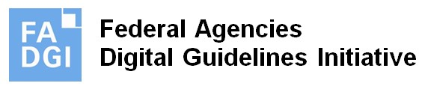
Updating Open Source AV Preservation Tools to Better Serve the Preservation Community
Morgan Oscar Morel
Dave Rice
Charlie Hosale
Video Lab Supervisor, Library of Congress
Lead Developer, RiceCapades
Archivist, Library of Congress
mmorel@loc.gov
dericed@gmail.com
chos@loc.gov
IASA September 2024
Valencia, Spain

Slide 2

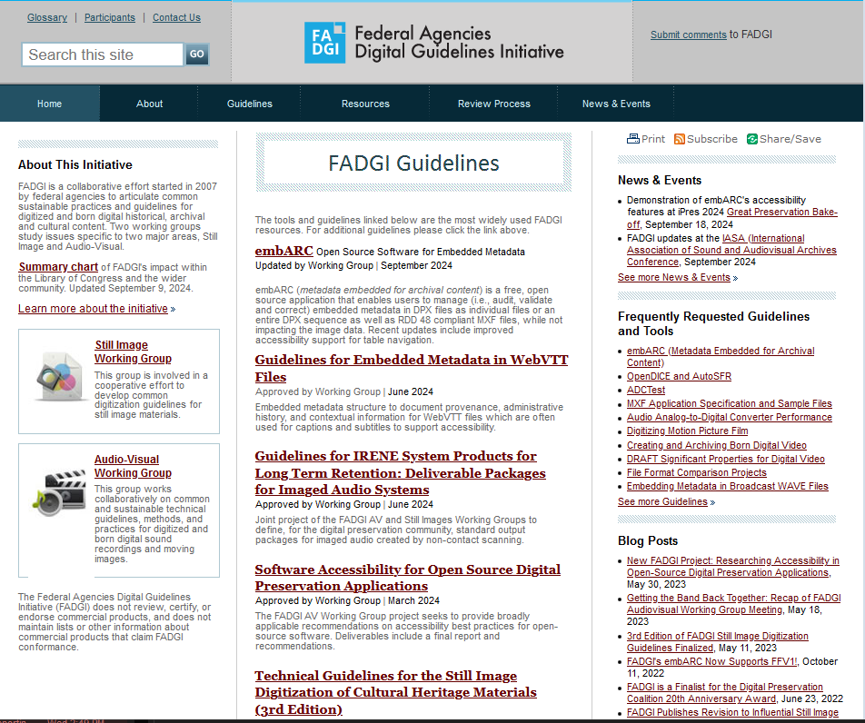
http://www.digitizationguidelines.gov
Notes:
Hello, I am Morgan Morel, the Video Lab Supervisor at the Library of Congress. Charlie Hosale, an archivist at the American Folklife Center at the Library of Congress in the United States of America sends his regards and is joining us online - he planned to do this intro but recently became a father and was not able to travel for this presentation.
In my role at LC I participate in the Federal Agencies Digital Guidelines Initiative, or “FADGI”.
I’ll start with a short introduction about FADGI. FADGI stands for the US Federal Agencies Digital Guidelines Initiative
We are 20 institutional members all US federal agencies and mostly from the cultural heritage community. LC, National Archives and Records Administration, Smithsonian, National Library of Med are typical participants but also the more technical and scientific agencies like NOAA and NASA for some specific projects. FADGI is led by LC but is a cooperative and collaborative group.
We have two Working Groups:
-one focused on still images
-The other, which I work with, is the Audio Visual working group which focuses on audio, video and motion picture film:
We regularly post updates about our work on The Signal blog.
Today Dave and I are discussing FADGI’s efforts with open source development, primarily v-record. You can find us at digitizationguidelines.gov, and in the image on screen I’ve highlighted resources relevant to this talk, including our recently published study on software accessibility in common AV archive software.
All FADGI products have defined Creative Commons licenses - CC0 1.0 Universal License for worldwide use and reuse – and are always free of charge. check out our website or catch up with us for more information.

Slide 3
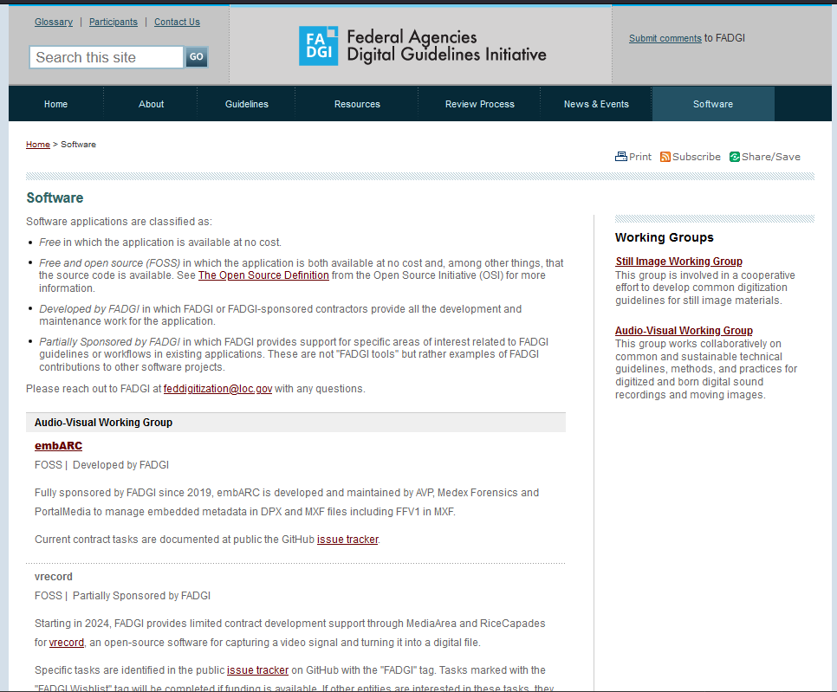
http://www.digitizationguidelines.gov/software
Notes:
The AV working group has a strong history of working with open source projects. We’ve collaborated on and supported development of embARC, BWF MetaEdit, FFmpeg, and vrecord. We consult with FADGI members and identify features and improvements that would benefit federal institutions. Through this work FADGI has gradually grown our processes and I hope our takeaways will be helpful for you too.
I’m also pleased to announce that we’ve launched a new page highlighting our work on software - digitization guidelines.gov slash software. Check it out!

Slide 4
Guidelines: Software Accessibility for Open Source Digital Preservation Applications
Literature review and research
Accessibility testing and analysis of three open-source applications related to digital preservation:
embARC (‘metadata embedded for archival content’)
BWF MetaEdit
Handbrake
Reported findings, recommendations, and guidelines for improved accessibility in FOSS apps
https://blogs.loc.gov/thesignal/2024/01/fadgi-report-software-accessibility-for-open-source-applications/
Notes:
FADGI’s also supports and performs research and advocacy for accessibility features in FOSS software. We recently completed a project with AVP and Tech For All to evaluate three FOSS tools that FADGI members use and report guidelines and recommendations. The guidelines were implemented in embARC which now serves as an example, and also in BWF MetaEdit, which Dave will tell you about now!

Slide 5

BWFMetaEdit
Character support for CP437, CP850, CP858, Windows-1252, ISO 8859-1, ISO 8859-2 encoded fields
Add options to bypass some EBU R98-1999 (CodingHistory) limitations (ANALOG vs ANALOGUE, comma at EOL, >48k frequencies, ...)
Support single XML export with all metadata (bext, cues, LIST-INFO, axml, file attributes, etc).
File management and writing optimization

Slide 6
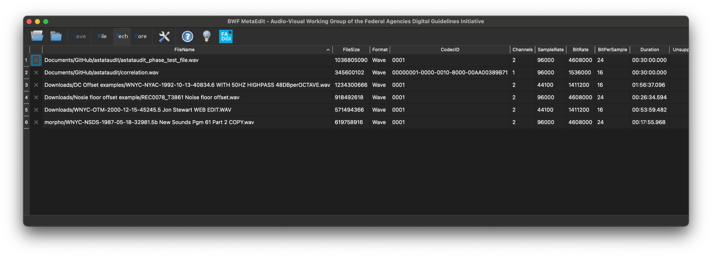
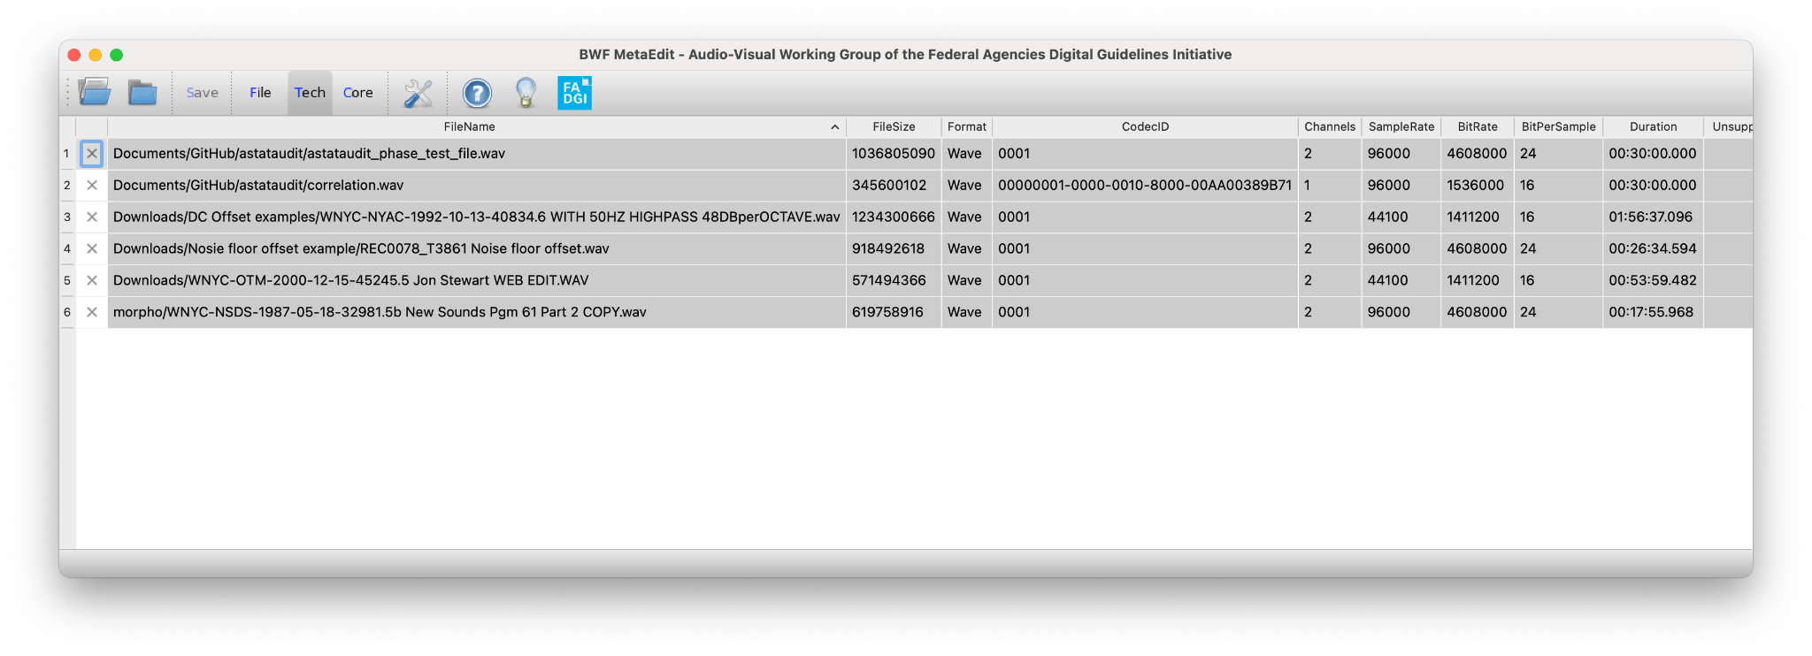
BWFMetaEdit
Notes:
- accessibility and dark mode

Slide 7

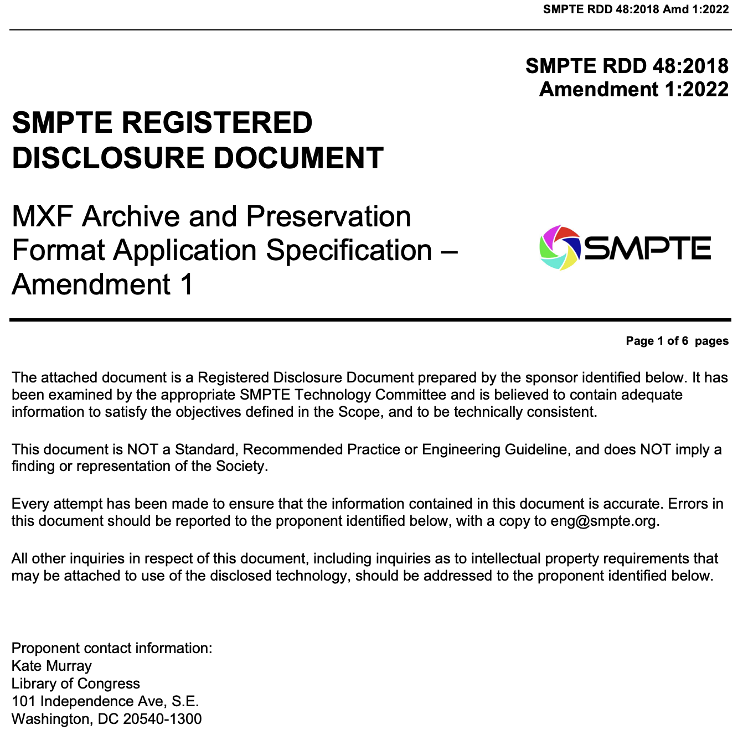
FFmpeg
Copying JPEG2000 from MXF to Matroska
Copying JPEG2000 from Matroska to MXF
Copying FFV1 from MXF to Matroska
Copying FFV1 from Matroska to MXF
Notes:
- discuss patch fro jpeg2000 in mxf and 2 images per KLV

Slide 8
FFmpeg
<?xml version="1.0"?>
<MediaTimecode xmlns="https://mediaarea.net/mediatimecode">
<media>
<timecode_stream id="1-Material" format="smpte-st377" frame_rate="30000/1001" frame_count="600" start_tc="01:00:00;00"/>
<timecode_stream id="1-Source" format="smpte-st377" frame_rate="30000/1001" frame_count="600" start_tc="01:00:00;00"/>
<timecode_stream id="2-Source" format="smpte-st377" frame_rate="30000/1001" frame_count="600" start_tc="03:00:00;00"/>
<timecode_stream id="3-Source" format="smpte-st377" frame_rate="30000/1001" frame_count="600" start_tc="03:00:00;00"/>
<timecode_stream id="4-Source" format="smpte-st377" frame_rate="30000/1001" frame_count="114" start_tc="00:00:02;04"/>
<timecode_stream id="SystemScheme1-0-0" format="smpte-st331" frame_rate="30000/1001" fp="0" bgf="0" bg="0">
<tc v="01:00:00;00"/>
<tc v="01:00:00;01"/>
<tc v="01:00:00;02"/>
<tc v="01:00:00;03"/>
<tc v="21:00:04;20"/>
Timecode in Matroska
Notes:
- discuss timecode in matroska

Slide 9
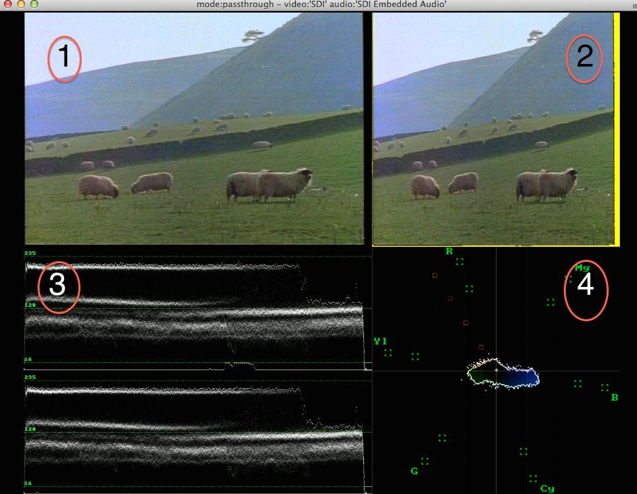
vrecord
Open Source software for creating preservation-grade digital recordings from video tape
The tool was built by archivist, for archivists, and contains many useful features and tools
Built-in Waveform and Vector Scopes
Ability to create FFV1/MKV Files
Built in QCTools reports and Conformance Checking
Notes:
The last project we’ll be talking about today is vrecord. Vrecord is a tool used for creating preservation-grade digital recordings from video tape. The tool began as an AMIA hackday project, and has since been adopted by a number of archives, vendors, and non-profit organizations across the world. At its most simple, vrecord functions as an interface that runs on top of BlackMagic’s capture Software Development Kit, and provides a number of useful features that BlackMagic’s capture software doesn’t, including built in scopes, FFV1/MKV support, QCTools report creation, Conformance checking, the creation of framemd5s, and many other tools that are particularly useful for folks performing digitization and video capture for archival preservation.

Slide 10
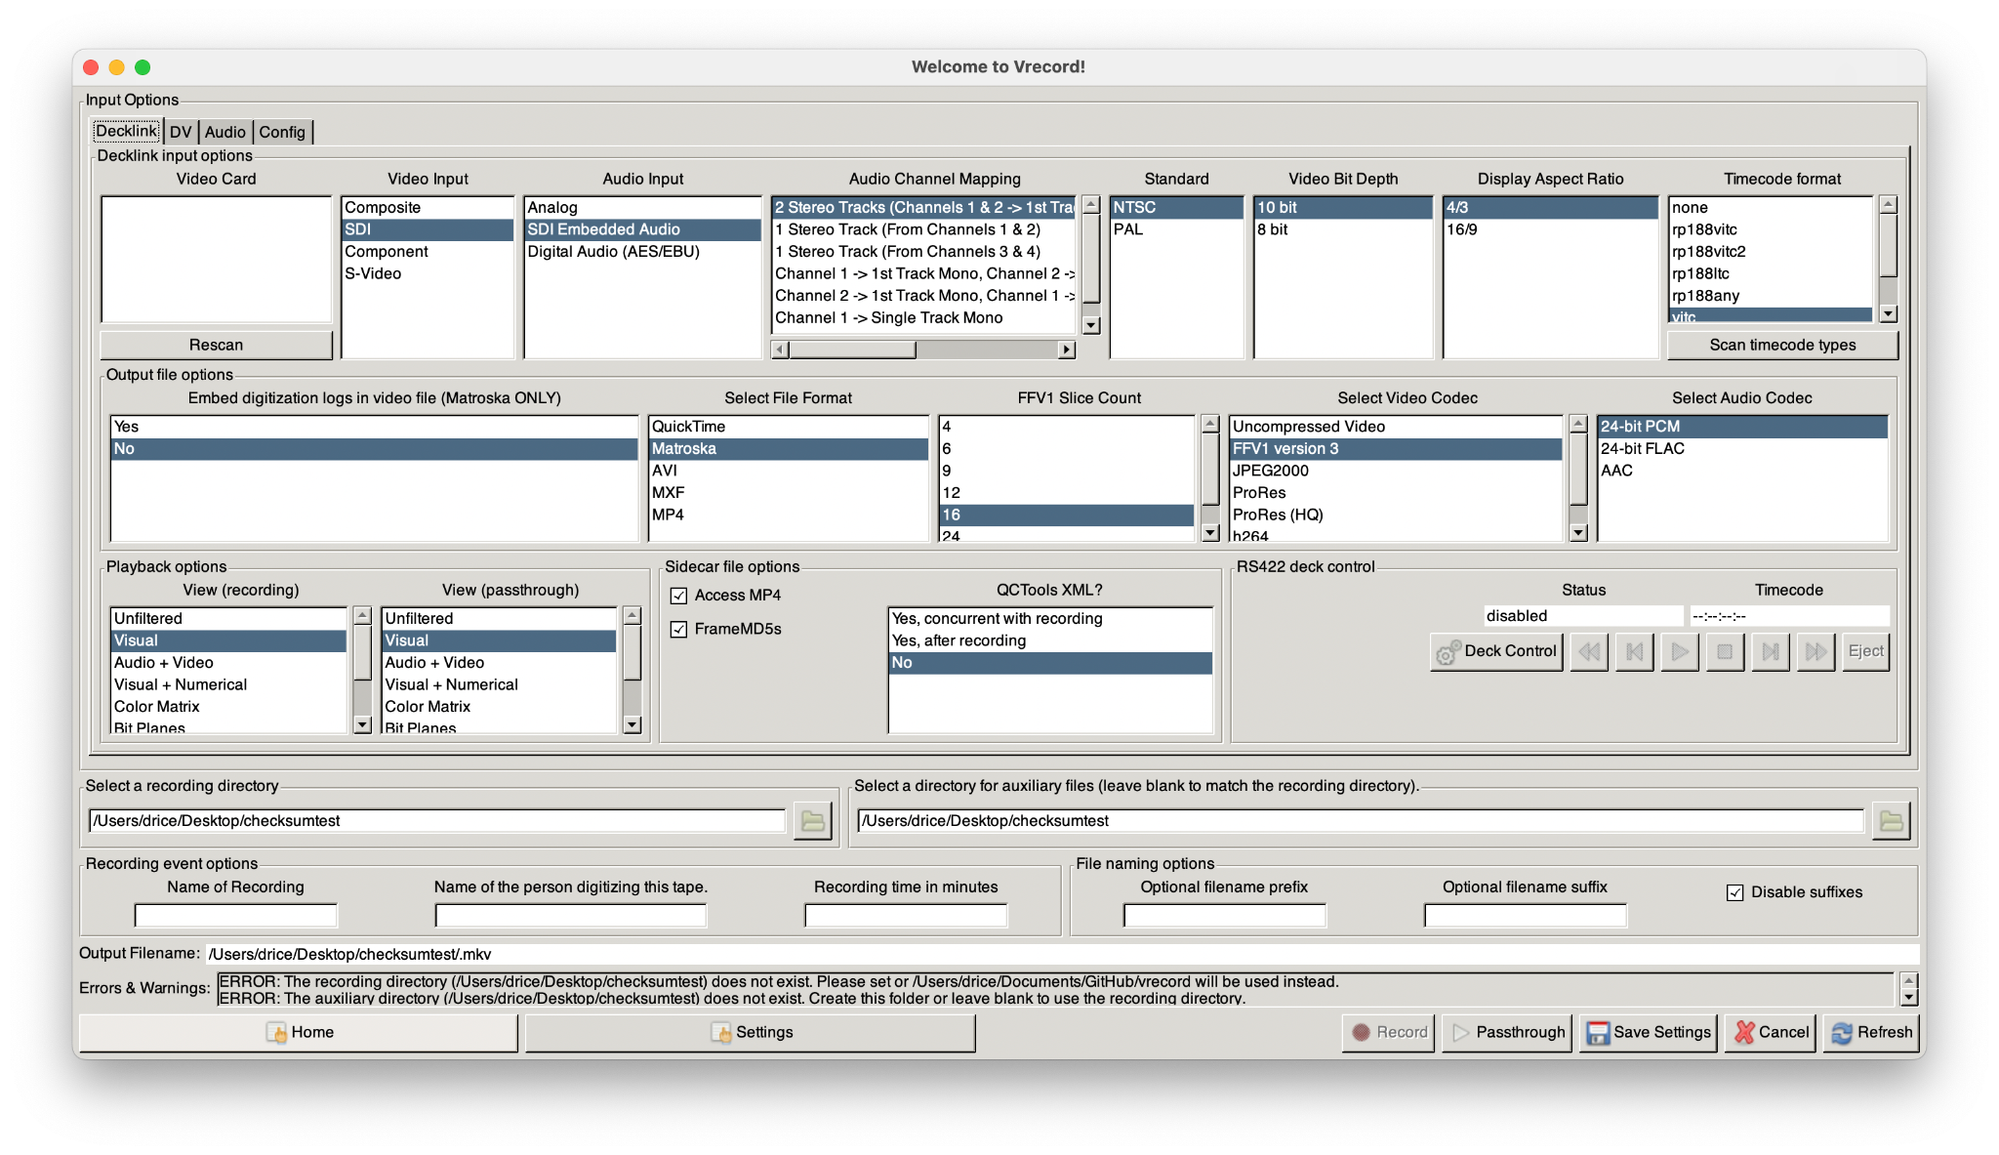
vrecord
Notes:
The last project we’ll be talking about today is vrecord. Vrecord is a tool used for creating preservation-grade digital recordings from video tape. The tool began as an AMIA hackday project, and has since been adopted by a number of archives, vendors, and non-profit organizations across the world. At its most simple, vrecord functions as an interface that runs on top of BlackMagic’s capture Software Development Kit, and provides a number of useful features that BlackMagic’s capture software doesn’t, including built in scopes, FFV1/MKV support, QCTools report creation, Conformance checking, the creation of framemd5s, and many other tools that are particularly useful for folks performing digitization and video capture for archival preservation.

Slide 11
vrecord
Notes:
The last project we’ll be talking about today is vrecord. Vrecord is a tool used for creating preservation-grade digital recordings from video tape. The tool began as an AMIA hackday project, and has since been adopted by a number of archives, vendors, and non-profit organizations across the world. At its most simple, vrecord functions as an interface that runs on top of BlackMagic’s capture Software Development Kit, and provides a number of useful features that BlackMagic’s capture software doesn’t, including built in scopes, FFV1/MKV support, QCTools report creation, Conformance checking, the creation of framemd5s, and many other tools that are particularly useful for folks performing digitization and video capture for archival preservation.

Slide 12
vrecord
Notes:
The last project we’ll be talking about today is vrecord. Vrecord is a tool used for creating preservation-grade digital recordings from video tape. The tool began as an AMIA hackday project, and has since been adopted by a number of archives, vendors, and non-profit organizations across the world. At its most simple, vrecord functions as an interface that runs on top of BlackMagic’s capture Software Development Kit, and provides a number of useful features that BlackMagic’s capture software doesn’t, including built in scopes, FFV1/MKV support, QCTools report creation, Conformance checking, the creation of framemd5s, and many other tools that are particularly useful for folks performing digitization and video capture for archival preservation.

Slide 13
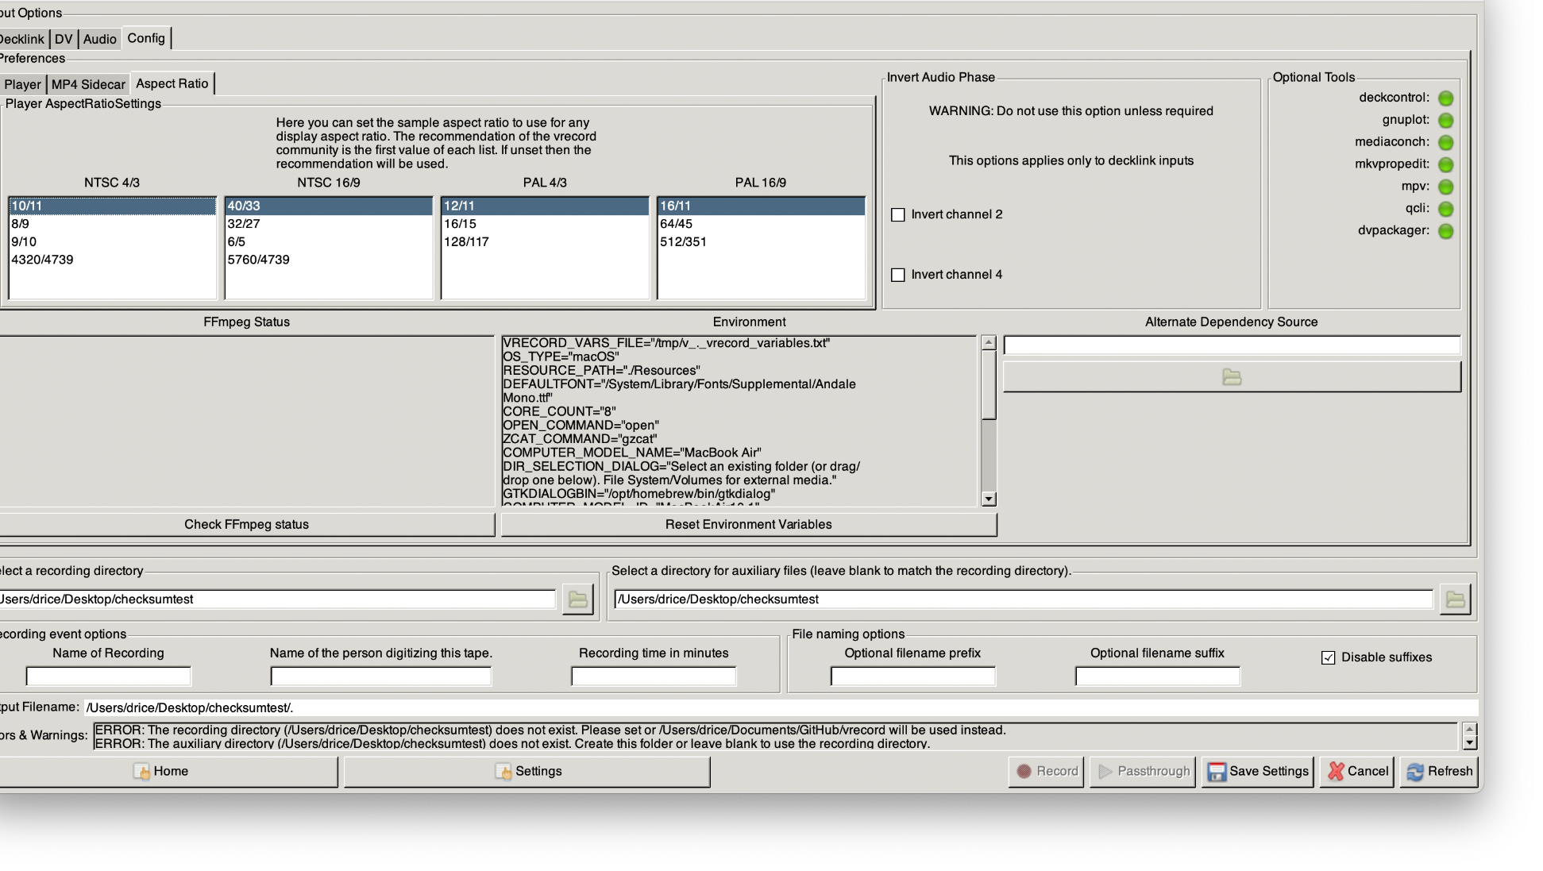
Notes:
The last project we’ll be talking about today is vrecord. Vrecord is a tool used for creating preservation-grade digital recordings from video tape. The tool began as an AMIA hackday project, and has since been adopted by a number of archives, vendors, and non-profit organizations across the world. At its most simple, vrecord functions as an interface that runs on top of BlackMagic’s capture Software Development Kit, and provides a number of useful features that BlackMagic’s capture software doesn’t, including built in scopes, FFV1/MKV support, QCTools report creation, Conformance checking, the creation of framemd5s, and many other tools that are particularly useful for folks performing digitization and video capture for archival preservation.

Slide 14
Proposed Enhancements
Create H.264
Access files concurrently with Preservation files
Simple Record Mode
vrecord
.pkg installer
Proposed Enhancements are meant to address the needs of Federal Agencies using vrecord
Notes:
In 2024 FADGI has had a contract with Ricecapades to work on a number of enhancements to vrecord. The proposed enhancements include:
Creation of H.264 concurrent with the capture of preservation files. Meaning that an H.264 access file can be created at the same time that the preservation file is being captured, eliminating the need for transcoding post-capture, so long as you don’t plan to perform an audio or video editing, adjusting or removing content that is in the preservation file.
The second is the creation of a Simple Record mode interface. This would be a simplified interface that allows users to select a profile and capture video quickly without needing to navigate the more complex options available when setting up a capture.
The third is the creation of a package installer, which would make installation as easy as downloading and running the installer file. Currently, vrecord must either be built manually from source, which would be fairly excruciating, or can be built using homebrew, which is significantly easier but still presents some issues for novice users.
These enhancements are all meant to make vrecord more usable by federal agencies. For example, the creation of concurrent h.264 files will allow the tool to be easily deployed in the NAVCC video lab with a need for any large-scale automation updates. Also, the package installer would be transformative for federal agencies with particularly strict IT departments, where it’s common that installers of software are required in order to gain approval. Of course, we’re also hoping that these enhancements are helpful to folks throughout the av preservation community, not just federal agencies. The simple record mode, for example, could be used in community preservation stations where the more advanced interface could be a burden to novice users,

Slide 15
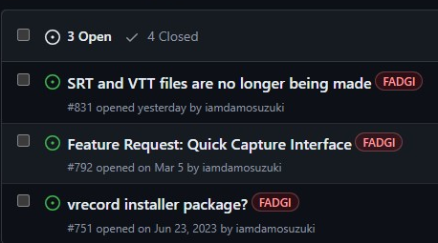
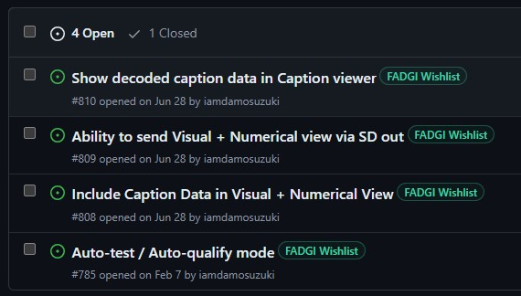
Tracking Progress
https://github.com/amiaopensource/vrecord/issues
Tags for tickets addressing FADGI-sponsored updates
Tags for tickets addressing wishlist updates
Notes:
As Charlie mentioned, FADGI has a history of funding open source software development. However, in this case instead of developing new tools, we’re branching into supporting new features in existing tools that have high adoption in the av preservation community. As part of this new approach, we’ve deployed a tagging system in the GitHub Issue tracker for vrecord. We have a FADGI tag and a FADGI Wishlist tag. The FADGI tag allows us to track issues and pull requests that are related to the current contract that we have with the developers. The Wishlist tag allows us to gauge the user community’s interest in these potential enhancements, which we can then use to inform any potential future development.

Slide 16


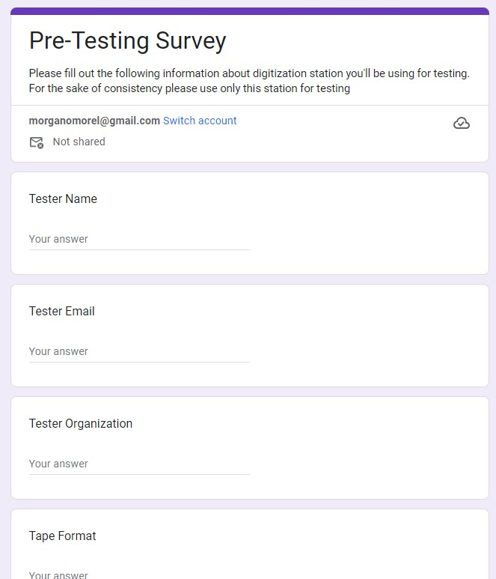

User Testing
Testers sent Google Form to fill for pre-testing and for each feature test
Test files sent to me via mediashuttle for further inspection
Users are testing specific versions deployed in homebrew
Notes:
User Testing is an important of this process as well, since there is an ever-growing vrecord user community. We need to make sure of two things:
That these enhancements work properly and are addressing the expressed needs of Federal Agencies users.
That these enhancements are not breaking vrecord’s existing functionality
We put together a test user group consisting of Federal Agencies users and other av preservationists. Then sent out a doc that had instructions for installing the latest version and creating test files. Then, we included a link to google forms that asked the users questions about their pre-test setup, and walked users through creating and analyzing the test files. The test files are also sent to me for further analysis. The google forms allow us to easily track the testing processes for each user and enhancement.

Slide 17

Current Status & Challenges
Create H.264
Access files concurrently with Preservation files
Simple Record Mode
vrecord
.pkg installer
Completed, tested, and deployed
Awaiting a code refactor sponsored by NYPL
Currently only possible if x264 library is not included
Notes:
Here’s the current status. The creation of the h.264 access files enhancement has been completed, tested, and deployed. This deployment included an additional feature that had been sponsored by NYPL, which allows vrecord to detect closed captioning data on line 21, save it as an scc file, and automatically transcode the scc data into an SRT or WebVTT file. We’re very excited about both of these features being deployed in the latest version, so go and check them out!
Simple record mode has made progress, but it’s awaiting a potential code refactoring that will be sponsored by NYPL. This code refactor will change the methods by which user input and configuration is received, which is a big part of how the Simple Record Mode will work. That’s why we’re waiting
The Package installer is coming along, but has its own set of difficulties. Currently, it is only possible to legally package and distribute vrecord if the x264 library is not included. Because of an ambiguity in the Black Magic SDK’s EULA, any GPL licensed libraries cannot be packaged and distributed in an app that also uses the black magic SDK. This isn’t a huge roadblock however, it will just take some time to test other H.264-alternative libraries that could legally be bundled in the installer

Slide 18
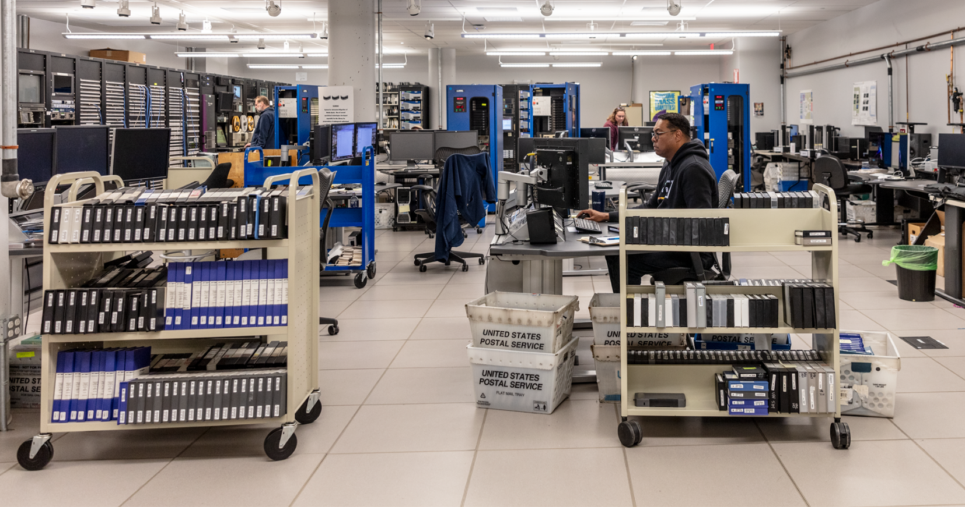
NAVCC Video Lab
Notes:
I’d also like to take a minute to discuss how this fits in with the work that we’re doing in the NAVCC Video Lab. NAVCC is working on deploying sixteen mac-mini based video capture stations in our video lab. These capture stations will use vrecord to create FFV1/MKV preservation files, along with h.264 MP4 access files. This is something we’ve been working towards for a long time, and has been made possible partly by these vrecord enhancements, as well as efforts of the Library of Congress’s recommended formats statement work group, which made FFV1/MKV a preferred format last year. We’ve also worked closely with the interra system, the makers of Baton, the software we use for automated QC, to build test profiles for FFV1/MKV files. At this point Baton can now detect format errors with MKV/FFV1 files, including incorrect format specifications and failed slice CRCs. We still have a ways to go, mostly navigating internal workflows, and preparing our network and physical infrastructure, but we’re getting closer and closer to using open source software to capture FFV1/MKV in Library of Congress’s video lab!

Slide 19

Morgan Oscar Morel
Dave Rice
Charlie Hosale
Video Lab Supervisor, Library of Congress
Lead Developer, Ricecapades
Archivist, Library of Congress
mmorel@loc.gov
dericed@gmail.com
chos@loc.gov
IASA September 2024
Valencia, Spain
Notes:
That’s it. Does anyone have any questions?

